Slide 1
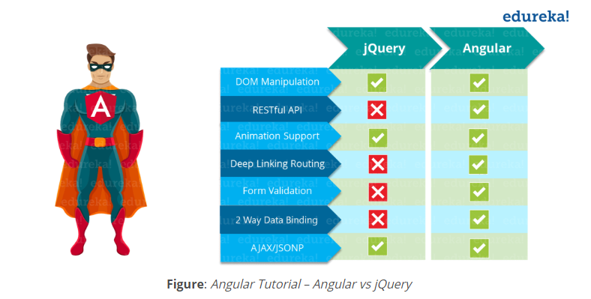

Slide 2
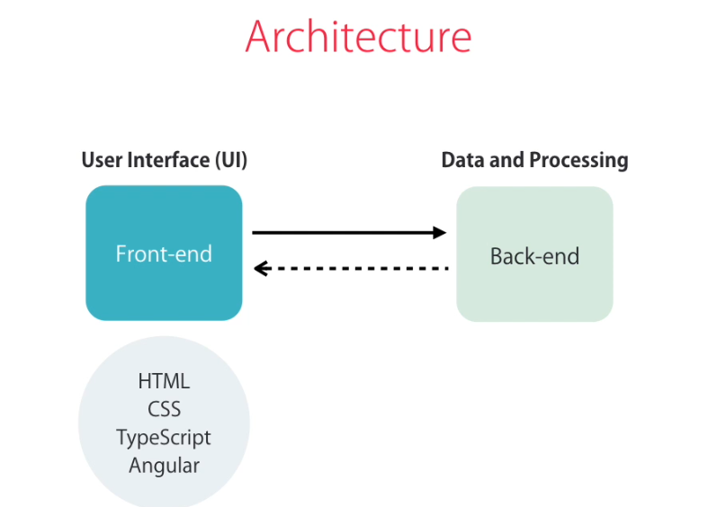

Slide 3


Slide 4
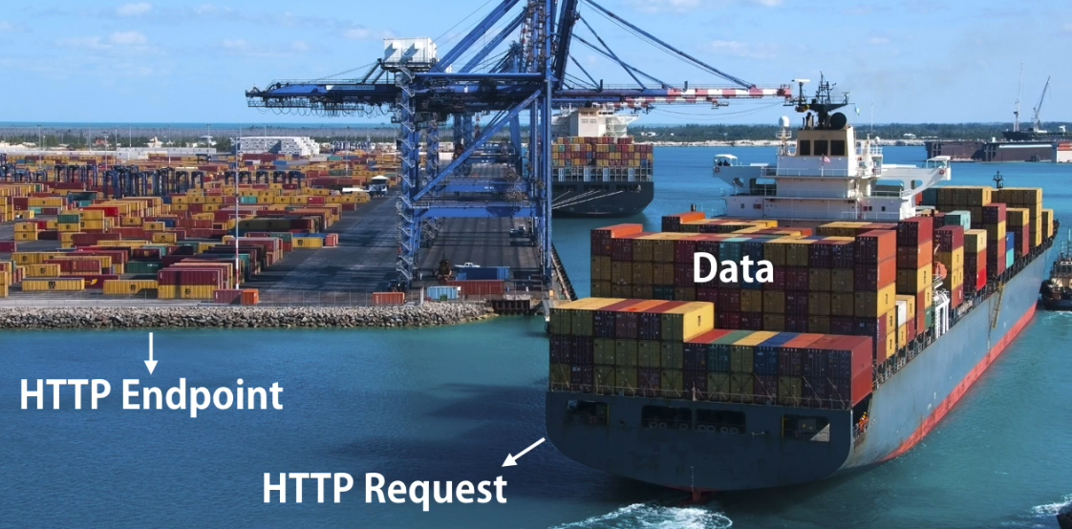

Slide 5
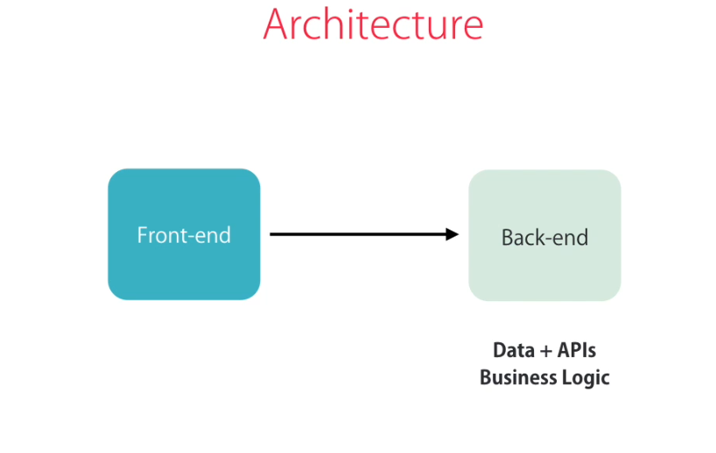

Slide 6
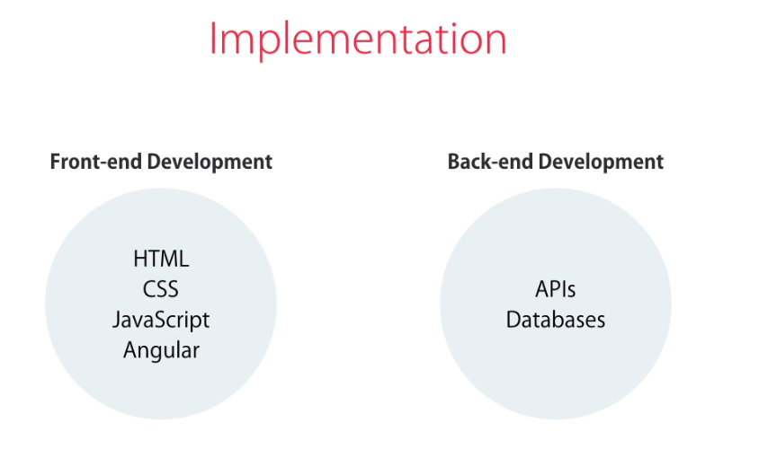

Slide 7
Install node
node –v
npm install –g @angular/cli
ng -v
If –g is not mentioned the npm will install the angular in the current working project only

Slide 8
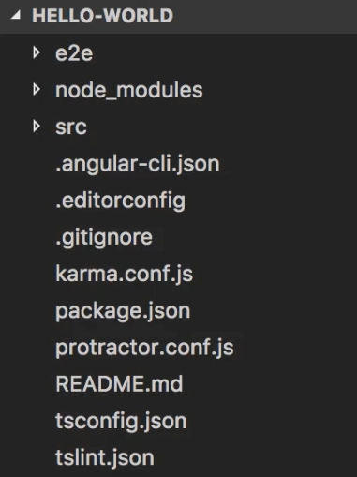
To create a new project => ng new <project-name>

Slide 9
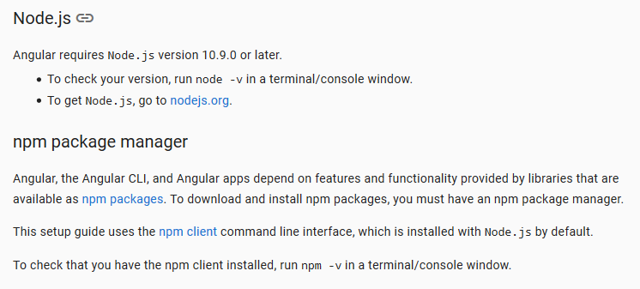

Slide 10
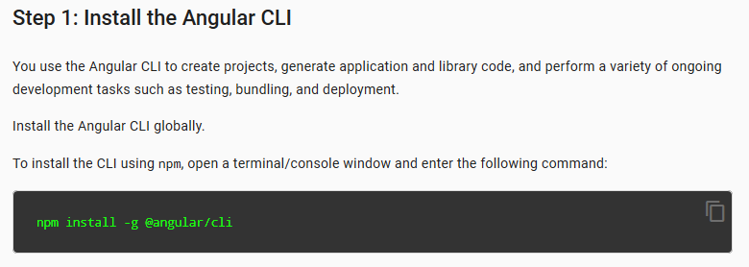

Slide 11
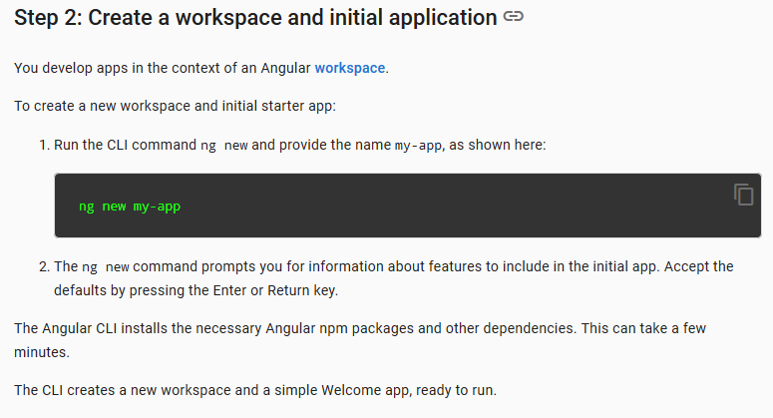

Slide 12
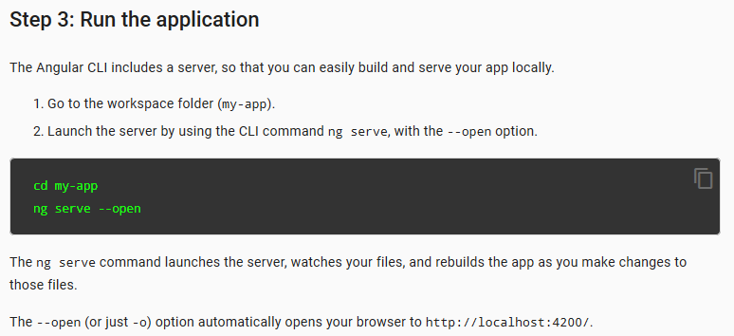

Slide 13
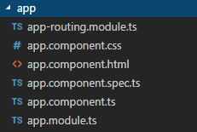
Every Application should have atleast one module and one component

Slide 14
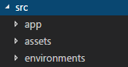
Our projects source code are written in src folder. The app folder inside src folder consists of modules and components
The assets contains the static files such as images etc…. In environments folder configuration settings of different environments
Is placed .

Slide 15
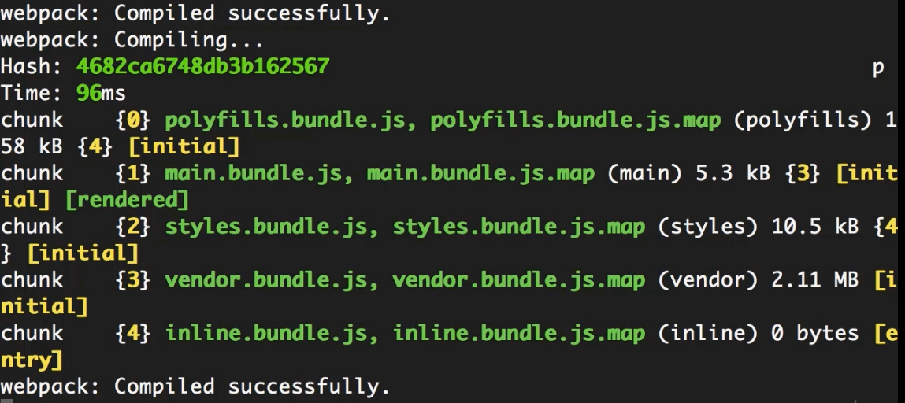

Slide 16
Webpack are inbuild in angular cli which will wrap the src code into minimized bundles.
Polyfills Bundle → specifies the versioning of javascript ( ES5 )
Main Bundle → specifies the main programing
Style Bundle → specifies the style components
Vendor Bundle → includes all third party libraries
Whenever any change in the application ,webpack automatically recompiles the application and refreshes the bundle
A tool that creates bundles for JavaScript code and stylesheets and injects those bundles into index.html at run-time.

Slide 17

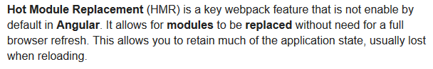

Slide 18
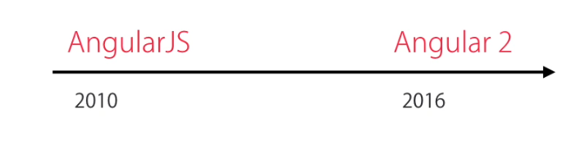

Slide 19
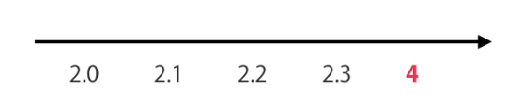
Angular

Slide 20
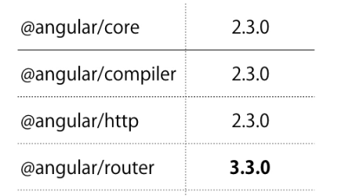
Why Angular 2 directly to Angular 4 ?
The angular version changes with some updates after Angular 2.0 . From the Above table the core, compiler and http
are belongs to same version but router belongs to Angular 3 . So in order to get rid of the confusion they introduced
Angular 4 with all the above features correlated

Slide 21
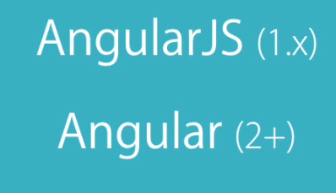
By concluding there are two versions of angular , AngularJS and Angular

Slide 22
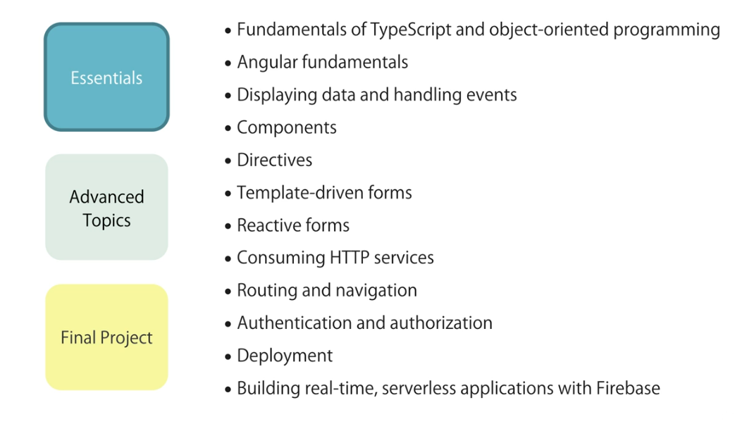

Slide 23
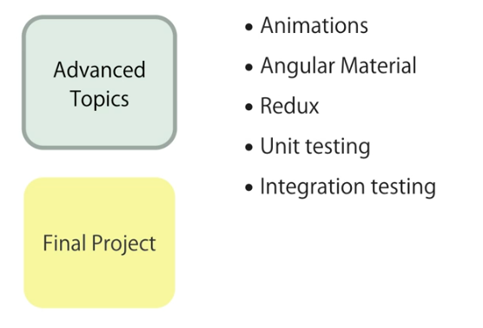

Slide 24
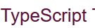
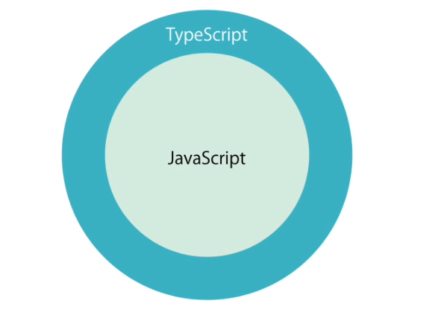
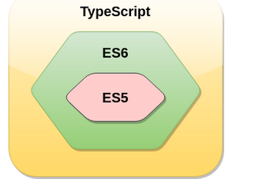
TypeScript is an open-source object-oriented programing language.
It is developed and maintained by Microsoft under Apache 2 license.
TypeScript is a strongly typed superset of JavaScript that compiles to plain JavaScript.
TypeScript is a language for application-scale JavaScript development.
TypeScript is not directly run on the browser. It needs a compiler to compile and generate in JavaScript file.
TypeScript source file is in ".ts" extension. We can use any valid ".js" file by renaming it to ".ts" file.
TypeScript is the ES6 version of JavaScript with some additional features.

Slide 25

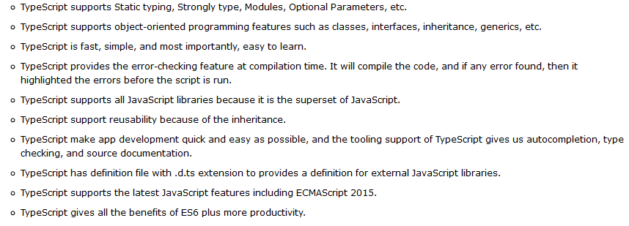

Slide 26
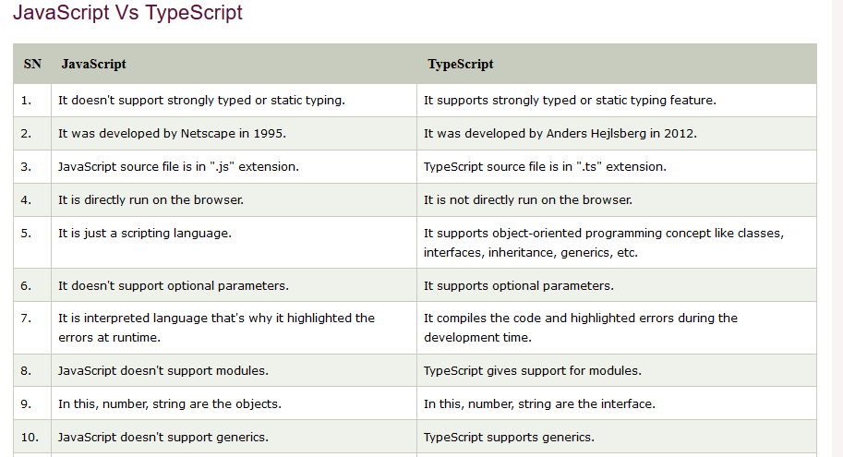

Slide 27
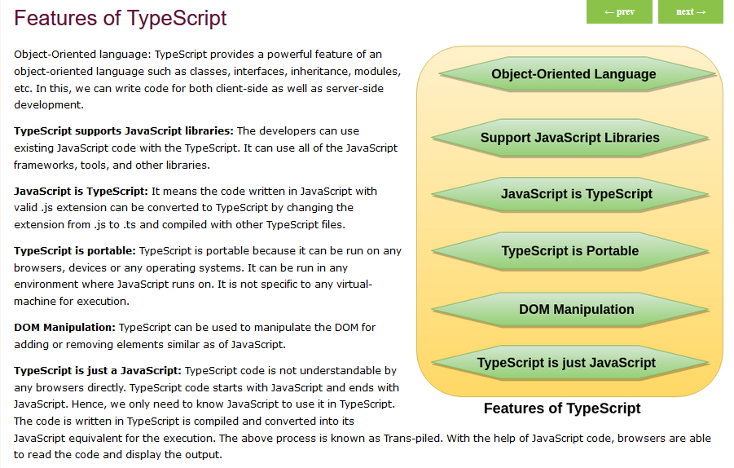

Slide 28
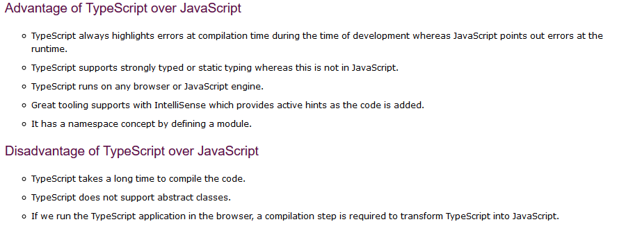

Slide 29
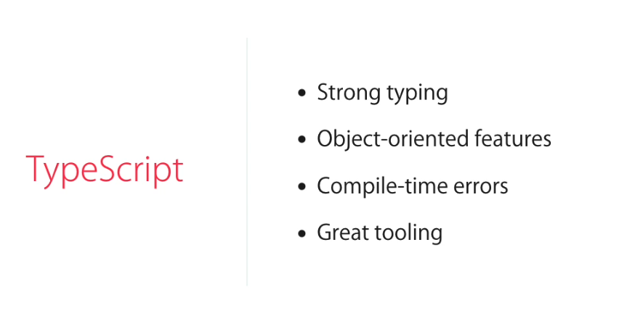

Slide 30
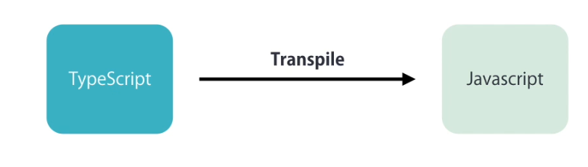

Slide 31
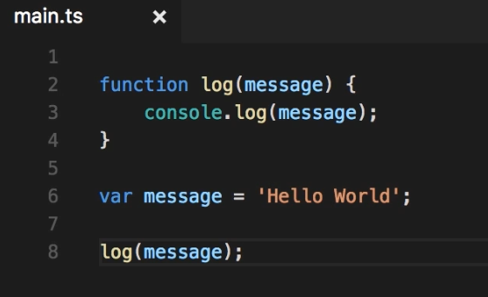

Slide 32
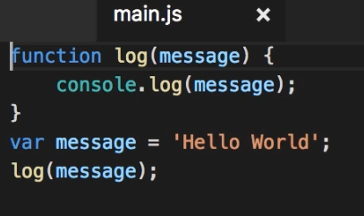
tsc main.ts (produce main.js file)

Slide 33
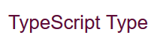
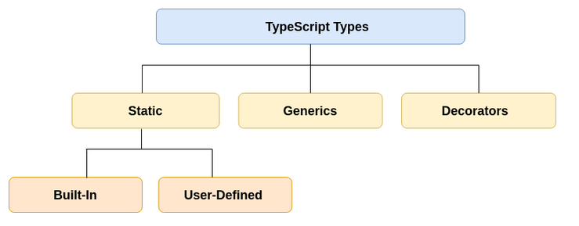
The TypeScripts language supports different types of values.
It provides data types for the JavaScript in order to transform it into a strongly typed programing language.
JavaScript doesn't support data types, but with the help of TypeScript, we can use the data types feature in JavaScript.

Slide 34
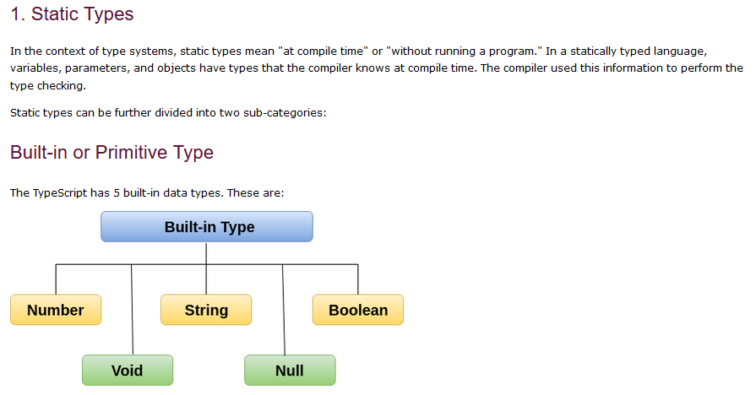

Slide 35
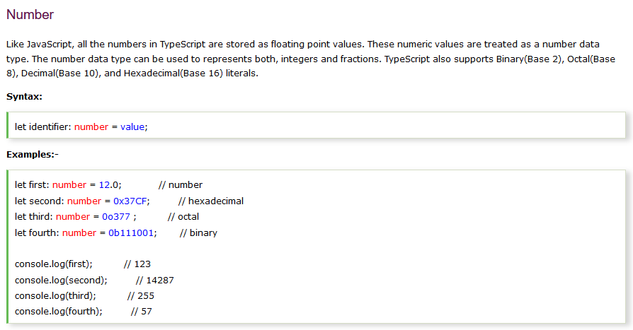

Slide 36
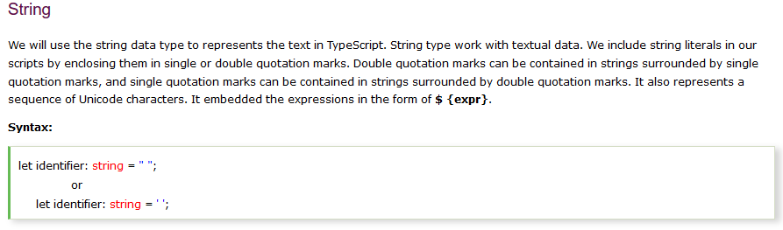
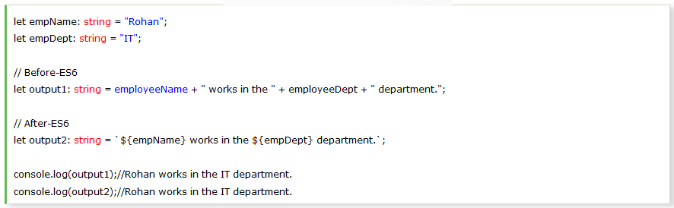

Slide 37
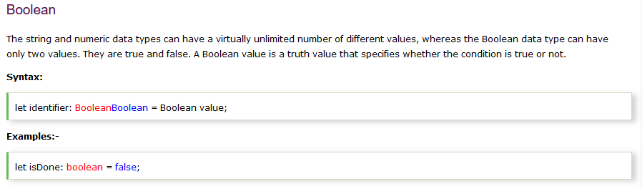

Slide 38
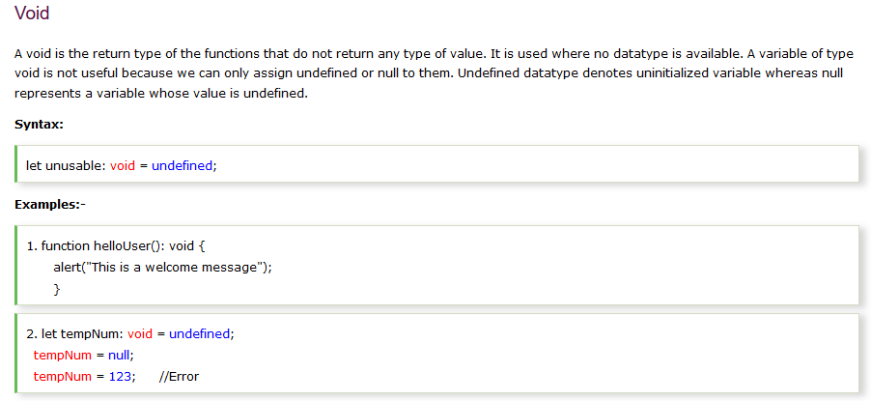

Slide 39
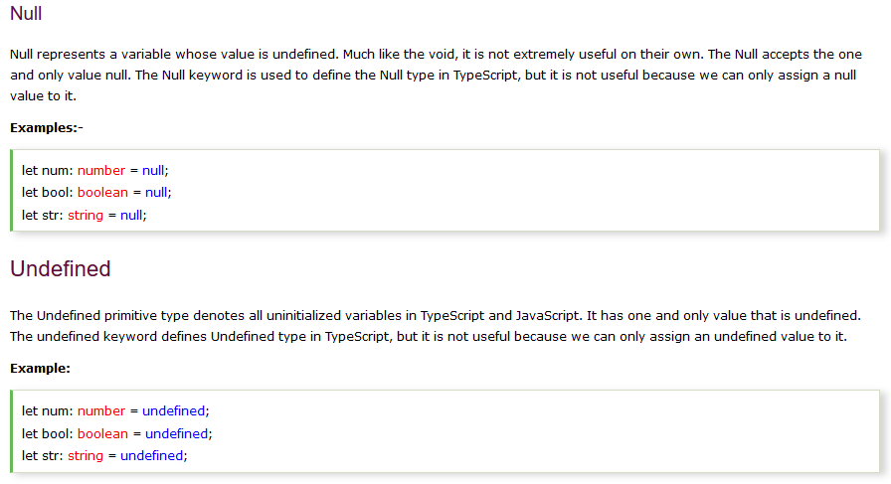

Slide 40
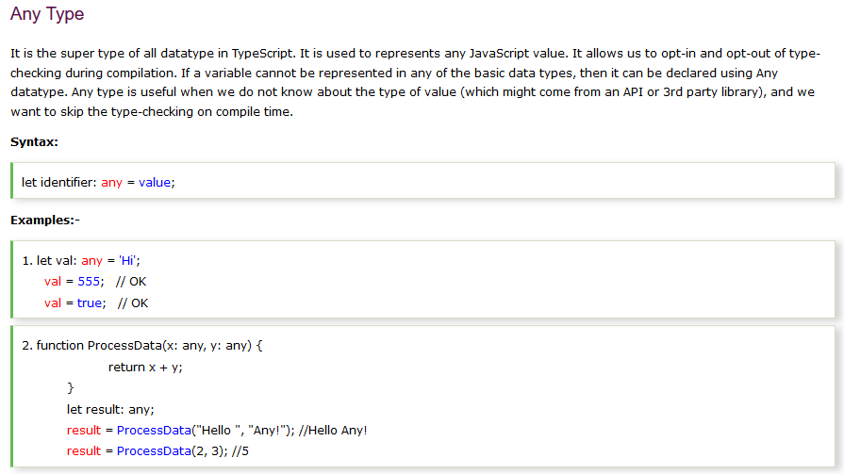

Slide 41
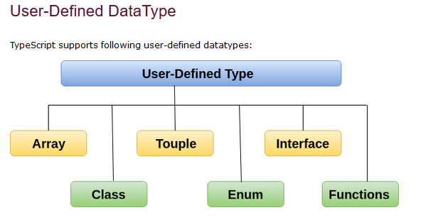
Tuple

Slide 42
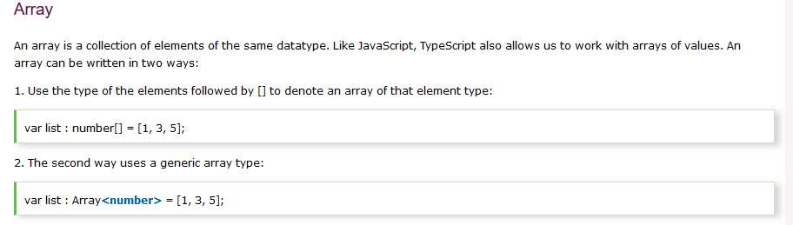
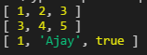
var list:number[] = [1,2,3]
var list1:Array<number>=[3,4,5]
var list2:any=[1,"Ajay",true]
console.log(list);
console.log(list1);
console.log(list2)

Slide 43
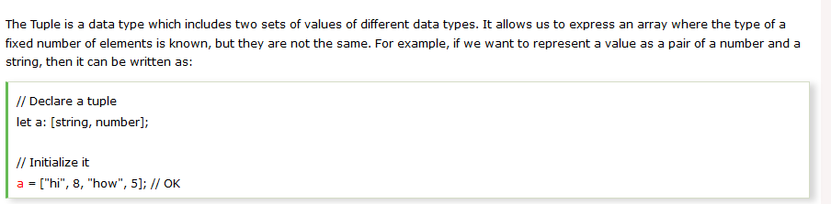
Tuple

Slide 44
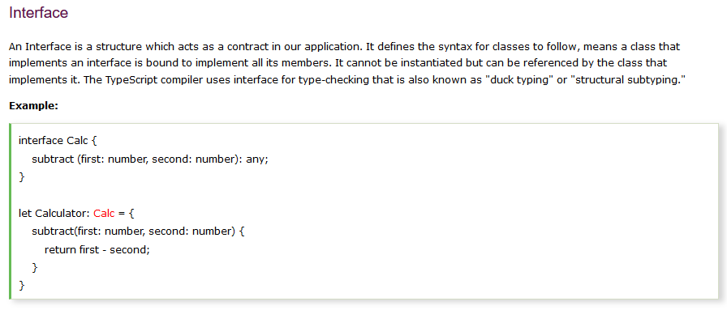

Slide 45
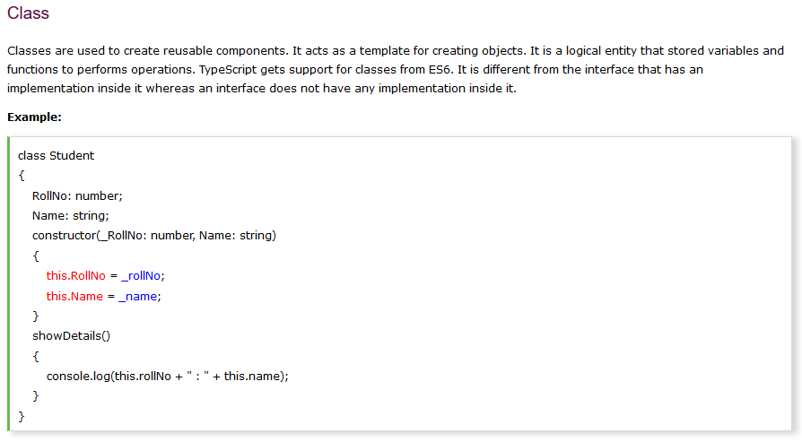

Slide 46
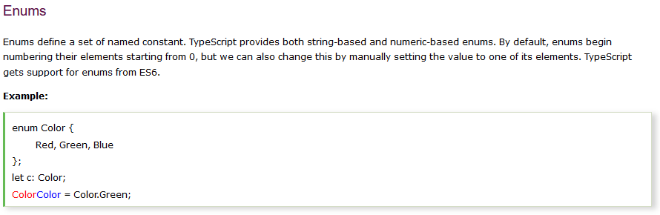

Slide 47
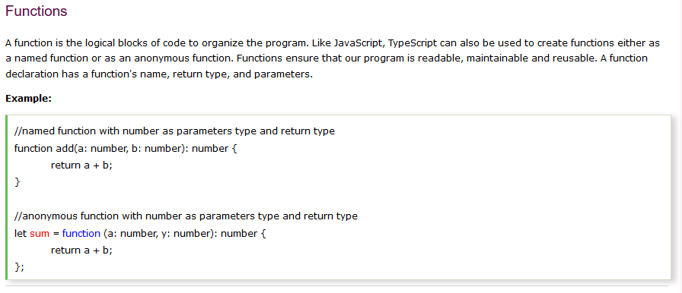

Slide 48
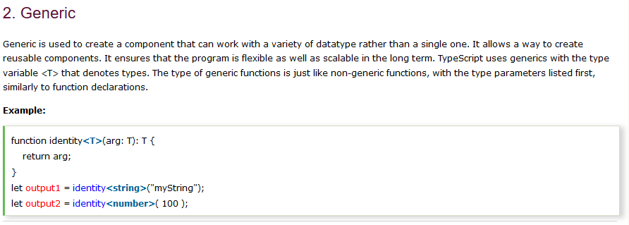

Slide 49


Slide 50


Slide 51




Slide 52


Slide 53


Slide 54


Slide 55


Slide 56



Slide 57


Slide 58
interface Address{
pinCode:number
state:string
}
interface Person extends Address{
name:string
age:number
getName():string
getAge():number
}
class Student implements Person{
name:string
age:number
pinCode:number
state:string
getName=()=>this.name
getAge=()=>this.age
constructor(name:string,age:number){
this.age=age;
this.name=name
}
}
let s1 = new Student("Ajay",25);
console.log(`${s1.getName()} and ${s1.getAge()}`);

Slide 59


Slide 60


Slide 61

class Point{
x:number
y:number
constructor(x?:number,y?:number){
this.x=x
this.y=y
}
}
let point1 = new Point()
console.log(`x : ${point1.x} , y : ${point1.y}`)
let point2 = new Point(1)
console.log(`x : ${point2.x} , y : ${point2.y}`)
let point3 = new Point(1,2)
console.log(`x : ${point3.x} , y : ${point3.y}`)
The constructor overloading can only achieved by default parameter. This can be achieved by placing ? Operator next to
parameter

Slide 62


By default all members are private

Slide 63
class Car{
private name:string
public setName(name:string):void{
this.name=name
}
public getName():string{
return this.name
}
}
let car1 = new Car();
car1.setName("Mercond")
console.log(car1.getName());

Slide 64

From the above code the constructor automatically creates the members and initialize them

Slide 65


point.ts

Slide 66

main.ts

Slide 67


Angular provides built-in features for animation, http service, and materials which in turn has features such as auto-complete, navigation, toolbar, menus, etc. The code is written in TypeScript, which compiles to JavaScript and displays the same in the browser.

Slide 68




Components
The components encapsulates the data , the Html markup and the logic for the view
Every Application has a component called AppComponent or RootComponent

Slide 69

Modules
Module in Angular refers to a place where you can group the components, directives, pipes, and services, which are related to the application.
In case you are developing a website, the header, footer, left, center and the right section become part of a module.
Every Application has one module which is call AppModule
****For larger application the main module is divided into many modules***

Slide 70

Creating Component

Slide 71


Create a component in src/app folder (courses.component.ts)
For multiple word separate by hyphen (course-forum.component.ts )

Slide 72


Register the component in app.module.ts in the declaration list in @NgModules

Slide 73


Slide 74



Add the component in the app.component.html

Slide 75


Slide 76

Creating Components using Angular CLI
ng → Angular Module
g → generate
c → component
course → Component Name
ng g c course
By the use of this command angular automatically creates a component , register the component in the module

Slide 77

DATABINDING
We use curly braces for data binding - {{}} → this process is called interpolation

Slide 78


Slide 79


app.component.html

Slide 80


Slide 81

If the dynamic loading wants to be updated then place astrick(*) symbol before ngFor

Slide 82


Slide 83


Service
The list of data's have to be collected from the server(Http Service) using Angular Service
Create service with naming conversion <name>.service.ts in the app folder
Now we have to inject this service in the app.component.ts

Slide 84


Slide 85

Instead of creating →
constructor(){
let service = new CoursesService();
this.courses = service.getCourse();
}
Now we have to instruct angular to create an instance of CoursesService and pass it to the courses component. This is called Dependency Injection

Slide 86

Inorder for dependency injection we have to register the service in the module (app.module.ts)

Slide 87


Slide 88

Generating Services using Angular CLI
ng → Angular Module
g → generate
s → service
course → Component Name
ng g s email
Note : We have to provide the service in the module file for dependency injection

Slide 89


@Injectable → used only if the service has dependency in its constructor like

Slide 90

Property Binding
The property binding is the one way binding which flows from the component to the DOM.
This can be achieved by two way binding
We can use string interpolation ( {{ }} ) for adding text between tags such as h1 , div etc.… , for attributes we can use property binding. However we can use both string interpolation and property binding

Slide 91



colspan is not a known property i.e. the table works even if the colspan property is removed.
The img tag doesn’t work without src property so src is the known property of img
The angular binds the data for property not the Attribute
The HTML and the Dom has one-to-one Association

Slide 92

Solution → Attribute Binding
Place attr. as prefix with the property

Slide 93

Adding Bootstrap In the Project
npm install bootstrap --save
It downloads bootstrap in the node modules and the --save flag add the dependency in the package.json file
import the bootstrap to style.css

Slide 94



Slide 95


Class Binding

Slide 96

Style Binding
Here the background color of the button is white because isActive is false

Slide 97


Event Binding

Slide 98

Event Bubbling
With bubbling, the event is first captured and handled by the innermost element and then propagated to outer elements.

Slide 99


In this example the inner button was executed first and the div executed second when the button is clicked
The $event is used to get many methods such as x and y position

Slide 100

Getting x and y position in event binding
onSave ( $event ){
console.log(“$event.clientX , $event.clientY");
}
To Stop Event Bubbling

Slide 101

Filtering Events using Vanilla JavaScript
Here the log output occurs when hitting the enter key,
The Disadvantage of this implementation is the method is called for each key press,
The Angular provides a technique for the same implementation

Slide 102

Filtering Events using Angular
The keyup.enter method invokes when the user click the enter key
keyup.a → a key
Keyup.b → b key …….

Slide 103

Template Variable
Here the event.target.value returns the data entered in the input box
This is a ordinary vanilla JavaScript approach by passing the event property
The Angular provides the powerful mechanism of using variables in out template and those variable is called Template Variable

Slide 104

Using Template Variable
The template variables are defined by using hashtag ( # ) , here email is a template variable and the value of the variable email is passed to the function

Slide 105


Slide 106

Here in property binding the data flows from model to view. We have to update the model whenever there is a change in field

Slide 107


Two way binding using $event property ( Naive Approach )

Slide 108

Achieving Two Way Binding using Angular
In Angular [( ngModel )] is used for two way binding. We know that ngFor or ngIf is a directive which is used for manipulating the DOM. ngModel is used for two-way-binding
The error is familiar because the property ngModule doesn’t belongs to the input element
The ngModule is defined in angular form module, it is not defined in angular core module. So we have to register the FormsModule from the angular form to the app module

Slide 109


Registering FormsModule in AppModule.ts
FormModule
app.module.ts →

Slide 110

Pipes → Format Data

Slide 111



Slide 112


number: ‘2.2-3’ → round off number with two digit before decimal and after decimal has minimum of two digit and maximum of three digit ( {minIntegerDigits} . {minFractionDigits} - {maxFractionDigits} )

Slide 113
{{ course.releaseDate | date:'yyyy/MM-MMM-MMMM/dd/w-W/E-EEE-EEEE/a/h-H/m/s' }}
yyyy → year
MM →month number [ 1-12]
MMM→Abbrevated Month Name
MMMM → Full Month Name
dd → date
w →weeks of year
W →weeks
E →abbreviated day name
EEE → abbreviated day name
EEEE→ full day name
a → AM / PM
h →hours(1-12)
H →hours(1-24)
m →minutes
s →second
releaseDate :new Date(2019,5,8,16,13,25)
2019/06-Jun-June/08/23-2/Sat-Sat-Saturday/PM/4-16/13/25

Slide 114


Custom Pipe
<name>.pipe.ts

Slide 115

Register Pipe in app.module.ts

Slide 116



Slide 117


Custom Pipes with Arguments

Slide 118



Reusable Component

Slide 119

In order to make component reusable we have to add input and output property . We use input property to pass state or input to a component and we use output property for raise events from this custom component. The combinations of input and output component makes use of public API called Component API → Application Programming Interface

Slide 120



Here the favourite component doesn’t have the public API because it doesn’t have the input and output property
Our task is to make isFavourite as input property and change as the output event

Slide 121

Create a Component → ng g c favourite
Here we have to mark isFavourite as input property so we can use in property binding expression

Slide 122


Here we import the Input decorator and inject with the isFavourite variable , Now isFavourite becomes the property of the favourite component. Now the contents in the favourite.component.html is executed in the app.component.html

Slide 123


Here the favourite tag works , because now isFavourite is a property of favourite component

Slide 124

Another Approach of marking the variable as property
This Approach is redundant and angular team drop this approach

Slide 125

Aliase Naming

Slide 126

Output Property
Since favourite is a component change is not the event , so we have to register change as event

Slide 127



Import Output and EventEmitter
Here the change.emit() property gives the functionality of the change event as in javascript

Slide 128




Passing Event Data

Slide 129


Slide 130

Here the style apply to the every h1 tag in the body. This is tedious that’s why shadow DOM comes into play

Slide 131


Slide 132

View Encapsulation
Supports Shadow DOM

Slide 133

ng-content → Dynamic Content Loading
select attribute refers to the selector from the main html ( app.component.html ) in which the app loads

Slide 134

From here according to the selector the ng-content dynamically loads the data into the respective template

Slide 135



Slide 136

Here the card-header div contains another div because the ng-content takes the div class for respective implementation.
We can only take the contents by using ng-container instead of div tag

Slide 137


Now the card-header div has only the content

Slide 138

Directives

Slide 139

Since structural directives modify the structure of the dom we have to suffix with Astrick( * )symbol

Slide 140

ngIf – Directive
A structural directive that conditionally includes a template based on the value of an expression coerced to Boolean.

Slide 141


Approach Before Angular 4

Slide 142

After Angular 4
Using ng-template and template variable we can achieve the same task

Slide 143

Use of ngIf then and else

Slide 144

Hidden Property

Slide 145


ngIf Property | Hidden Property
Using ngIf if the condition evaluates to false the unresultant Div is removed from the DOM | Just hide the Div it doesn’t Remove

Slide 146




Slide 147


Slide 148





Slide 149




Slide 150


Slide 151


Slide 152

Change Detection in Angular
The Angular is build with AJAX call i.e. whenever any change detected the variable gets dynamically updated

Slide 153


Slide 154


Slide 155


New Row Dynamically Updated

Slide 156




Removing Element

Slide 157


Slide 158


Here every time I click the button Angular loads the data i.e. the same data is reloaded again and again . This is because By default Angular Track the Memory Location of the Object

Slide 159


Every Time when Object is created it allocates at different memory location
To Rectify that we can track by Id

Slide 160



Slide 161


Leading Asterisk ( * )
The Leading Asterisk Symbol will rewrite the HTML elements with Angular Elements
Leading Asterisk convert the above code to below code

Slide 162



Note: the class name should be enclosed in quotes.
The ngClass is an Attribute directive because it modifies the attributes of the DOM element

Slide 163




Slide 164




Safe Traversal Operator
Safe Traversal Operator
Now the browser doesn’t show error

Slide 165



Custom Directives ( ng g d <name> )
Boilerplate Code

Slide 166




Slide 167

Template Driven Forms
Forms are the mainstay of business applications.
You use forms to log in, submit a help request, place an order, book a flight, schedule a meeting, and perform countless other data-entry tasks.
In developing a form, it's important to create a data-entry experience that guides the user efficiently and effectively through the workflow.
Developing forms requires design skills (which are out of scope for this page), as well as framework support for two-way data binding, change tracking, validation, and error handling

Slide 168



Slide 169



Slide 170

We can create the control of the form using directives , in this way we call this as Template-Driven Forms.
The another approach involves we explicitly write the control object in our component these are called Reactive Forms

Slide 171


Slide 172

We have to specify a name attribute or use [(ngModel)]

Slide 173

( OR )
Here the ngModel directive have many validation for the form control
As a result the ngModel creates a form-control object under the hood

Slide 174

Directive
Template Variable

Slide 175


Control Object
Here many controls available as pairs such as dirty and pristine, valid and invalid, touched and untouched etc…..

Slide 176



*ngIf="(firstName.touched && !firstName.valid )”
Here if the input box is touched and leave without filling (because of required) then the alert division is displayed

Slide 177


Slide 178




Slide 179

{{ firstName.errors.minlength.requiredLength }}

Slide 180

Angular automatically binds the ngForm directive whenever it saw the form tag
Template Variable
Directive
Output Property
To Raise Custom Events

Slide 181


Slide 182


The ngForm creates a full fledged object which return all the validations of the field inside it.
We valid will returns true if the errors in the input forms are rectified. The value contains an object which holds the value of the input field in ( name:value ) JSON format. We can access by f.value[“firstName”] or f.value.firstName

Slide 183


ngModelGroup Creates and binds a FormGroup instance to a DOM element.

Slide 184




Slide 185

Validate for Particular Group

Slide 186


Slide 187



component.ts
component.html
The ngValue is used to bind the object to the variable

Slide 188

Reactive Forms
Reactive forms provide a model-driven approach to handling form inputs whose values change over time.
Reactive forms use an explicit and immutable approach to managing the state of a form at a given point in time.
Each change to the form state returns a new state, which maintains the integrity of the model between changes.
Reactive forms are built around observable streams, where form inputs and values are provided as streams of input values, which can be accessed synchronously.

Slide 189


Slide 190

Register Reactive Forms Module in app.module.ts

Slide 191



Slide 192

Creating Control Programmatically
In Angular AbstractControl is the parent class for FormControl and FormGroup

Slide 193


Creating FormControl Object

Slide 194


Association with objects

Slide 195

Adding Form Validation

Slide 196

import { Validators} from "@angular/forms";

Slide 197




The form.get(‘username’) returns the form control to the username object

Slide 198


Instead of using form.get(‘username’) we can use property
form.get(‘username’)

Slide 199


Custom Form Validators

Slide 200

<div *ngIf="username.errors.cannotContainSpaces">No spaces are needed</div>

Slide 201
Asynchronous Operation
Validating the input by the use of server data. When fetching data from the server their may be delay . If delay occurs then the process using our code gets blocked. Our task is to wait the process till the data is loaded and this task is called Asynchronous Operation (Non-Blocking) i.e the process that executes the task doesn’t block while waiting

Slide 202

setTimeOut
setInterval

Slide 203

Timer Function

Slide 204


Registering the Asynchronous Validator

Slide 205



Slide 206

<div *ngIf="username.errors.shouldBeUnique">Username Already Taken</div>
Returns true if the process get into waiting

Slide 207



Setting Errors
Using service to set errors

Slide 208

For Nested Form Group

Slide 209

username
password

Slide 210


FormArray

Slide 211


Slide 212


Slide 213

FormBuilder
Used for building form elements
Using FormBuilder we can rewrite the code to implement same

Slide 214



Slide 215

Reactive Forms Summarize

Slide 216

Consuming HTTP services

Slide 217



Slide 218

jsonplaceholder.typicode.com contains a bunch of json string in server in which we can use for our demo services (for fake we can use this service for the backend)
We can send various http request for performing CRUD operations

Slide 219

Getting Data
Register HttpModule in app.module.ts ( import {HttpModule} from “@angular/http” )

Slide 220


Slide 221



Slide 222



Converting the response object to json
Storing Data

Slide 223


Display Data in template

Slide 224


Creating Data → Post Data

Slide 225


Updating data
Can be achieved by patch or put method
Patch → update a specific property and returns full response
[ this.http.patch(this.url,JSON.stringify( {isRead:true} ) ) ]
Put → update a full request and return specific response
[ this.http.patch(this.url,JSON.stringify( post ) ) ]

Slide 226




Patch → Full Response
Put → specific Response

Slide 227




Slide 228

Deleting Data

Slide 229


Slide 230



Slide 231

Do not call http get method in constructor instead use ngOnInit

Slide 232
Separation of Concerns or Single Responsibility Principle
→states that each class should only has single responsibility
We have to maintain each class for post , get , put , patch and delete
Unit test fails → server fails
Automation test fails → http calls slow down automated test

Slide 233


Rectify
Doesn’t make http calls
Unit test fails → server fails
Automation test fails → http calls slow down automated test

Slide 234
Extracting A Service ( ng g s post )
Create the service
Register service in the provider for Dependency Injection
Create a service folder inside src/app
Move the services inside the service folder

Slide 235

Now the service acts as the bridge between the component and the server

Slide 236


Slide 237


Slide 238


Slide 239

Handling Errors → 2 types

Slide 240

Handling Unexpected Error

Slide 241

Handling Expected Error

Slide 242



Slide 243


Slide 244

Implementing Navigation

Slide 245

Mapping of Component
Navigation
Display corresponding component when given route becomes active

Slide 246

Configure the Routes
Import RouterModule from angular/router in app.module.ts

Slide 247



Adding Router Outlet

Slide 248


Add Router Link
This is a bad practice of using href tag in angular because using href tag will refresh the entire page i.e. routing is useless
Href → download all package
routeLink → download only the specific component package
Using RouteLink the resources where downloaded for only the first time and this technique is called Single Page Application (SPA)

Slide 249

For Route Parameters
Since we use the routerLink we can bind the parameter with the url
[routerLink]=“[ path , routeArgs1 , routeArgs2 , …………]”

Slide 250



RouterLinkActive are used to dynamically apply CSS class

Slide 251

Retreiving Parameter value inside component

Slide 252



Slide 253

Getting Specific Value
Getting all parameter
Check whether the key exists in the parameter
Returns All Key

Slide 254

paramMap is Observable so it has a subscribe method

Slide 255

While navigating the angular destroys one component and moves to other. So we have to subscribe the component

Slide 256


Observable
+ operator coverts string to integer
snapshot

Slide 257

Adding Optional Parameter to Routes
We can use queryParams property along with RouterLInk to send optional parameters

Slide 258


Getting Query Parameter

Slide 259

Navigate to other pages programmatically

Slide 260


Slide 261


Slide 262


Slide 263


Slide 264


Slide 265




Slide 266

Deployment

Slide 267


Slide 268

This code is used to Apply All the Optimization Technique

Slide 269

JIT compilation
The compiler traverse through the DOM and replace a specific Value for rendering and this process is called Just-In-Time ( JIT) Compilation (or) compilation that happens at run time

Slide 270

Dis-Advantage of JIT

Slide 271

Ahead-Of-Time Compilation
All Optimizations are run at compile time i.e. all the bundles are downloaded finally

Slide 272
Building Application with Angular CLI
This code is used to Apply All the Optimization Technique
This produce a dist folder in our application this folder can be copy pasted in the deployment server for hosting

Slide 273


Slide 274

During developement we want to make the navigation background color blue

Slide 275

During production we want to make the navigation background color white

Slide 276



Slide 277

Shortcut

Slide 278


Slide 279
Hosting To Git Pages
Create a repository
Push the project to the repository
npm i –g angular-cli-ghpages
ng build --prod --base-href=https://ajaykce.github.io/<repo-name>/
angular-cli-ghpages (or) ngh (run in Administrator mode )

Slide 280



Slide 281
Create a project in console.firebase.google.com
npm install –g firebase-tools
firebase login
firebase init
firebase deploy

Slide 282



Slide 283

Firebase Database

Slide 284


Slide 285


Slide 286


Slide 287

Animation

Slide 288


Slide 289


Slide 290


Slide 291


Slide 292


Slide 293


Slide 294


Slide 295


Slide 296

This state refers when an element is not created yet or it is removed from the DOM

Slide 297

During Add state the element transists from the void state to default state and during Remove the element transists from the default state to void state

Slide 298



Slide 299


Slide 300



Slide 301


Transition State
animations:[
trigger('fade',[
transition('void => *', [style({}), animate(2000, style({}))])
]),
]

Slide 302


Slide 303
Note that the style object repeated , we can define the style in void state as well as default(*) state

Slide 304

Void state
Default state

Slide 305




Alias Name

Slide 306



Slide 307


Slide 308


Slide 309


Slide 310


Angular Material ( material.angular.io )

Slide 311


Slide 312


Slide 313
npm -i –save @angular/cdk @angular/material @angular/animation hammerjs
Building Angular Theme
Executing Angular Material
For Animation
For gestures
Add theme to css
Import BrowserAnimationModule or NoopAnimationModule to app.module.ts

Slide 314



Slide 315



